Slide 1
The Big Idea
Software Architecture
Lecture 1

Slide 2
The Origins
Software Engineers have always employed software architectures
  Very often without realizing it!
Address issues identified by researchers and practitioners
  Essential software engineering difficulties
  Unique characteristics of programming-in-the-large
  Need for software reuse
Many ideas originated in other (non-computing) domains

Slide 3
Software Engineering Difficulties
Software engineers deal with unique set of problems
  Young field with tremendous expectations
  Building of vastly complex, but intangible systems
  Software is not useful on its own e.g., unlike a car, thus
  It must conform to changes in other engineering areas
Some problems can be eliminated
  These are Brooks’ “accidental difficulties”
Other problems can be lessened, but not eliminated
  These are Brooks’ “essential difficulties”

Slide 4
Accidental Difficulties
Solutions exist
  Possibly waiting to be discovered
Past productivity increases result of overcoming
  Inadequate programming constructs & abstractions
    Remedied by high-level programming languages
    Increased productivity by factor of five
    Complexity was never inherent in program at all

Slide 5
Accidental Difficulties (cont’d)
Past productivity increases result of overcoming (cont’d)
  Viewing results of programming decisions took long time
    Remedied by time–sharing
    Turnaround time approaching limit of human perception
  Difficulty of using heterogeneous programs
    Addressed by integrated software development environments
    Support task that was conceptually always possible

Slide 6
Essential Difficulties
Only partial solutions exist for them, if any
Cannot be abstracted away
  Complexity
  Conformity
  Changeability
  Intangibility

Slide 7
Complexity
No two software parts are alike
  If they are, they are abstracted away into one
Complexity grows non-linearly with size
  E.g., it is impossible to enumerate all states of program
  Except perhaps “toy” programs

Slide 8
Conformity
Software is required to conform to its
  Operating environment
  Hardware
Often “last kid on block”
Perceived as most conformable

Slide 9
Changeability
Change originates with
  New applications, users, machines, standards, laws
  Hardware problems
Software is viewed as infinitely malleable

Slide 10
Intangibility
Software is not embedded in space
  Often no constraining physical laws
No obvious representation
  E.g., familiar geometric shapes

Slide 11
Pewter Bullets
Ada, C++, Java and other high–level languages
Object-oriented design/analysis/programming
Artificial Intelligence
Automatic Programming
Graphical Programming
Program Verification
Environments & tools
Workstations

Slide 12
Promising Attacks On Complexity (In 1987)
Buy vs. Build
Requirements refinement & rapid prototyping
  Hardest part is deciding what to build (or buy?)
  Must show product to customer to get complete spec.
  Need for iterative feedback
Notes:
Brooks in 1987

Slide 13
Promising Attacks On Complexity (cont’d)
Incremental/Evolutionary/Spiral Development
  Grow systems, don’t build them
  Good for morale
  Easy backtracking
  Early prototypes
Great designers
  Good design can be taught; great design cannot
  Nurture great designers
Notes:
Brooks in 1987

Slide 14
Primacy of Design
Software engineers collect requirements, code, test, integrate, configure, etc.
An architecture-centric approach to software engineering places an emphasis on design
  Design pervades the engineering activity from the very beginning
But how do we go about the task of architectural design?

Slide 15
Analogy: Architecture of Buildings
We all live in them
(We think) We know how they are built
  Requirements
  Design (blueprints)
  Construction
  Use
This is similar (though not identical) to how we build software

Slide 16
Some Obvious Parallels
Satisfaction of customers’ needs
Specialization of labor
Multiple perspectives of the final product
Intermediate points where plans and progress are reviewed

Slide 17
Deeper Parallels
Architecture is different from, but linked with the product/structure
Properties of structures are induced by the design of the architecture
The architect has a distinctive role and character

Slide 18
Deeper Parallels (cont’d)
Process is not as important as architecture
  Design and resulting qualities are at the forefront
  Process is a means, not an end
Architecture has matured over time into a discipline
  Architectural styles as sets of constraints
  Styles also as wide range of solutions, techniques and palettes of compatible materials, colors, and sizes

Slide 19
More about the Architect
A distinctive role and character in a project
Very broad training
Amasses and leverages extensive experience
A keen sense of aesthetics
Deep understanding of the domain
  Properties of structures, materials, and environments
  Needs of customers

Slide 20
More about the Architect (cont’d)
Even first-rate programming skills are insufficient for the creation of complex software applications
  But are they even necessary?

Slide 21
Limitations of the Analogy…
We know a lot about buildings, much less about software
The nature of software is different from that of building architecture
Software is much more malleable than physical materials
The two “construction industries” are very different
Software deployment has no counterpart in building architecture
Software is a machine; a building is not

Slide 22
…But Still Very Real Power of Architecture
Giving preeminence to architecture offers the potential for
  Intellectual control
  Conceptual integrity
  Effective basis for knowledge reuse
  Realizing experience, designs, and code
  Effective project communication
  Management of a set of variant systems
Limited-term focus on architecture will not yield significant benefits!

Slide 23
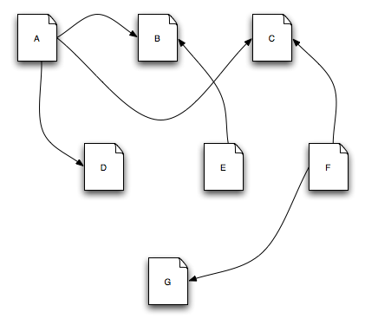
Architecture in Action: WWW
This is the Web
Software Architecture: Foundations, Theory, and Practice; Richard N. Taylor, Nenad Medvidovic, and Eric M. Dashofy; © 2008 John Wiley & Sons, Inc. Reprinted with permission.

Slide 24
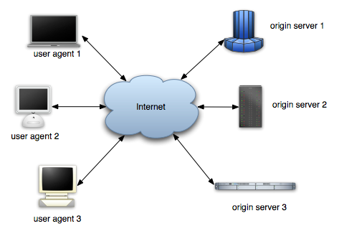
Architecture in Action: WWW
So is this
Software Architecture: Foundations, Theory, and Practice; Richard N. Taylor, Nenad Medvidovic, and Eric M. Dashofy; © 2008 John Wiley & Sons, Inc. Reprinted with permission.

Slide 25
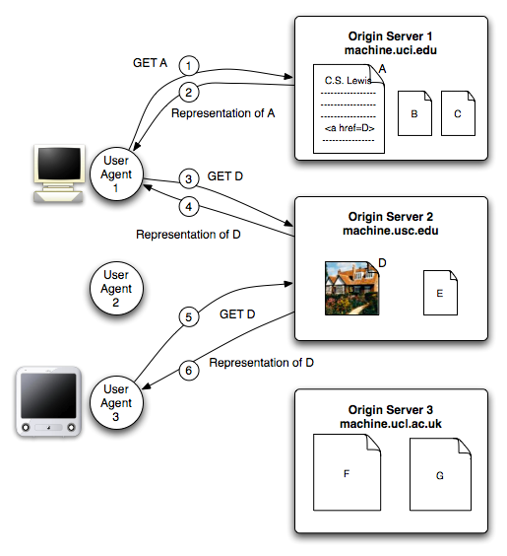
Architecture in Action: WWW
And this
Software Architecture: Foundations, Theory, and Practice; Richard N. Taylor, Nenad Medvidovic, and Eric M. Dashofy; © 2008 John Wiley & Sons, Inc. Reprinted with permission.

Slide 26
WWW in a (Big) Nutshell
The Web is a collection of resources, each of which has a unique name known as a uniform resource locator, or “URL”.
Each resource denotes, informally, some information.
URI’s can be used to determine the identity of a machine on the Internet, known as an origin server, where the value of the resource may be ascertained.
Communication is initiated by clients, known as user agents, who make requests of servers.
  Web browsers are common instances of user agents.

Slide 27
WWW in a (Big) Nutshell (cont’d)
Resources can be manipulated through their representations.
  HTML is a very common representation language used on the Web.
All communication between user agents and origin servers must be performed by a simple, generic protocol (HTTP), which offers the command methods GET, POST, etc.
All communication between user agents and origin servers must be fully self-contained. (So-called “stateless interactions”)

Slide 28
WWW’s Architecture
Architecture of the Web is wholly separate from the code
There is no single piece of code that implements the architecture.
There are multiple pieces of code that implement the various components of the architecture.
  E.g., different Web browsers

Slide 29
WWW’s Architecture (cont’d)
Stylistic constraints of the Web’s architectural style are not apparent in the code
  The effects of the constraints are evident in the Web
One of the world’s most successful applications is only understood adequately from an architectural vantage point.

Slide 30
Architecture in Action: Desktop
Remember pipes and filters in Unix?
  ls invoices | grep –e august | sort
Application architecture can be understood based on very few rules
Applications can be composed by non-programmers
  Akin to Lego blocks
A simple architectural concept that can be comprehended and applied by a broad audience

Slide 31
Architecture in Action: Product Line
Motivating example
  A consumer is interested in a 35-inch HDTV with a built-in DVD player for the North American market.
  Such a device might contain upwards of a million lines of embedded software.
  This particular television/DVD player will be very similar to a 35-inch HDTV without the DVD player, and also to a 35-inch HDTV with a built-in DVD player for the European market, where the TV must be able to handle PAL or SECAM encoded broadcasts, rather than North America’s NTSC format.
  These closely related televisions will similarly each have a million or more lines of code embedded within them.

Slide 32
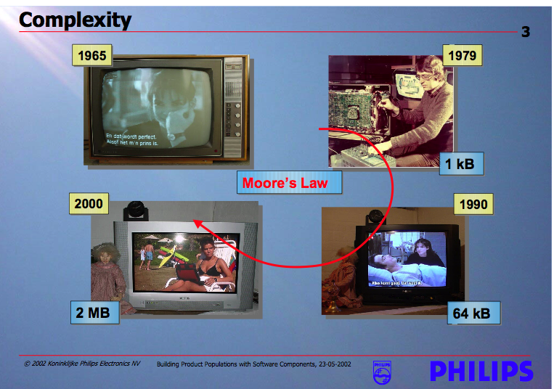
Growing Sophistication of Consumer Devices

Slide 33
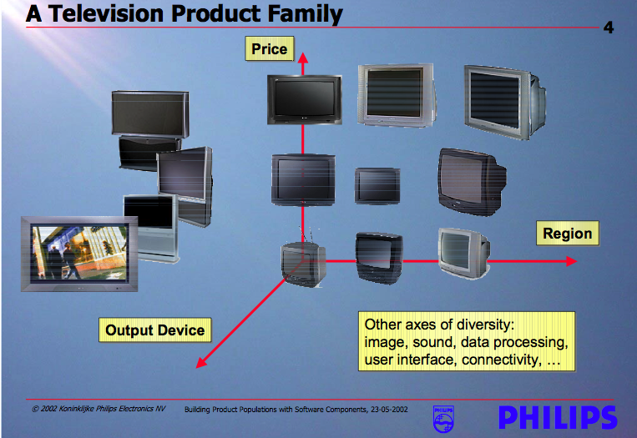
Families of Related Products

Slide 34
The Necessity and Benefit of PLs
Building each of these TVs from scratch would likely put Philips out of business
Reusing structure, behaviors, and component implementations is increasingly important to successful business practice
  It simplifies the software development task
  It reduces the development time and cost
  it improves the overall system reliability
Recognizing and exploiting commonality and variability across products

Slide 35
Reuse as the Big Win
Architecture: reuse of
  Ideas
  Knowledge
  Patterns
  engineering guidance
  Well-worn experience
Product families: reuse of
  Structure
  Behaviors
  Implementations
  Test suites…

Slide 36
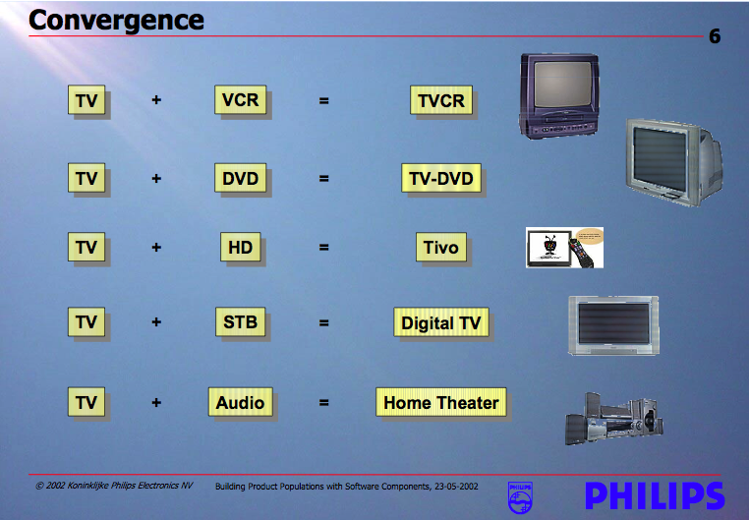
Added Benefit – Product Populations

Slide 37
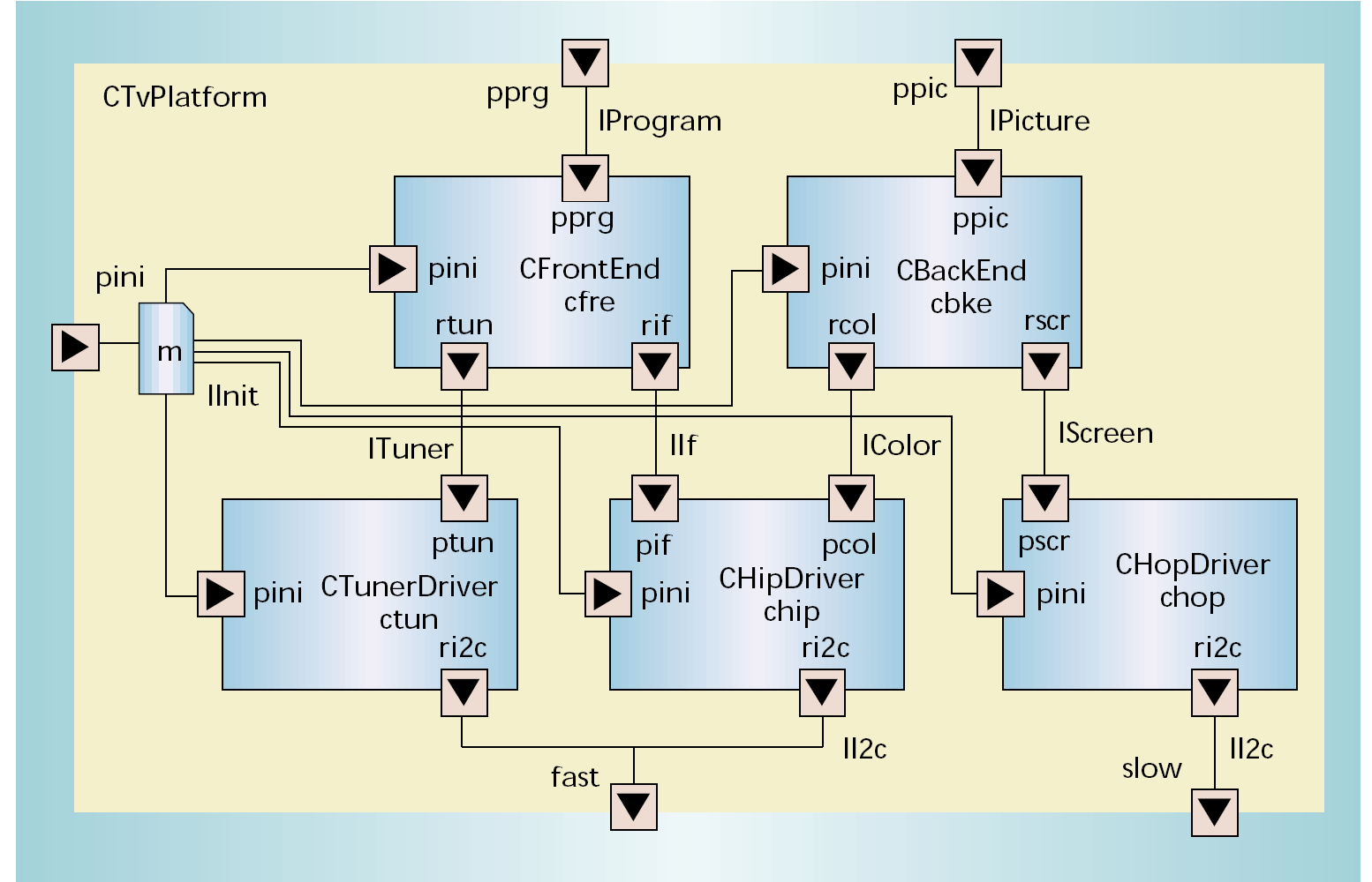
The Centerpiece – Architecture

Slide 38
Summary
Software is complex
So are buildings
  And other engineering artifacts
  Building architectures are an attractive source of analogy
Software engineers can learn from other domains
They also need to develop—and have developed—a rich body of their own architectural knowledge and experience

